Slide 1
A HYBRID DEMAND FORECASTING MODEL FOR AN EXPORT-DRIVEN NATURAL FIBRE INDUSTRY
GUIDED BY: Dr. MADHUSOODANAN M.R.
Department of Mechanical Engineering
PRESENTED BY: Antony John Berchmans
TCR24MEIM05
Date: 02-06-2026

Slide 2
INTRODUCTION
The natural fibre industry plays a vital role in sustainable manufacturing, supplying fibres like jute, coir, sisal, banana fibre, hemp, and bamboo to textiles, composites, packaging, and agriculture.
Global demand for natural fibres is rising, driven by increasing environmental awareness, bans on plastics, and the shift toward biodegradable materials
Despite its growth, the industry faces high variability due to climate conditions, rainfall patterns, pest attacks, and seasonal production cycles.
A hybrid forecasting approach becomes necessary to address the limitations of single models and produce more reliable demand predictions.
Improved forecasting accuracy helps reduce uncertainty, enabling companies to avoid overstocking, shortages, and price instability.
This study presents a hybrid forecasting model designed to enhance forecast reliability, support strategic decision-making, and strengthen competitiveness within the natural fibre industry.

Slide 3
OBJECTIVE
To analyse historical sales data of the export-driven natural fibre industry to identify seasonal, trend, and cyclical demand patterns.
To develop and implement time-series and machine learning models (ARIMA, SARIMA, XGBoost) for product demand forecasting.
To compare the forecasting performance of different models using statistical accuracy metrics such as MAE, RMSE, and MAPE.
To construct a hybrid forecasting framework that combines linear and non-linear modelling approaches to improve prediction accuracy.

Slide 4
LITERATURE REVIEW
Author & Year | Method Used | Key Finding | Limitation
Wang & Zain (2025) | Hybrid XGBoost-LSTM | Improved retail demand forecasting accuracy | High computational complexity
Kubek & Więcek (2025) | Hybrid ARIMA-Markov | Better forecasting for variable demand patterns | Limited nonlinear learning
Huang & Zhou (2025) | ARIMA-CNN-LSTM Hybrid | Reduced forecasting error significantly | Deep learning requires large datasets
Saivijayalakshmi et al. (2025) | Hybrid ARIMA-SARIMA-LSTM | Improved export forecasting accuracy | Model complexity increased
Chaudhuri & Alkan (2022) | Optimized Hybrid ML Model | Better nonlinear demand prediction | Less focus on seasonal demand

Slide 5
PROBLEM IDENTIFIED
High volatility and unpredictability in demand
Single forecasting models produce poor accuracy
Seasonal and trend components are not handled well individually
Sensitivity to outliers and data noise
Poor performance when demand fluctuates irregularly

Slide 6
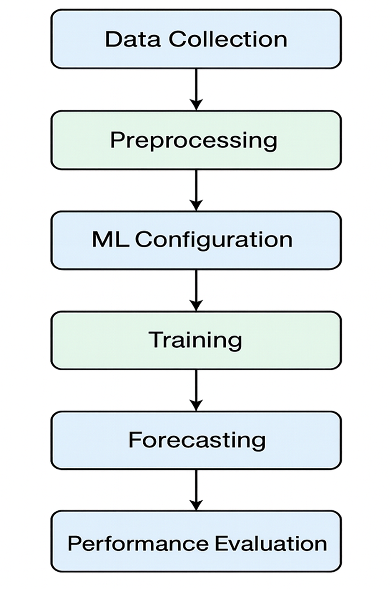
METHODOLOGY

Slide 7
METHODOLOGY
Uses real monthly sales data of a manufacturing company.
Use sales data to train the model.
Forecasts make the forecast for the upcoming year.
Compare traditional models (Naive, Moving Average, Regression) with the Hybrid model.
Compare and validate with accuracy metrics.

Slide 8
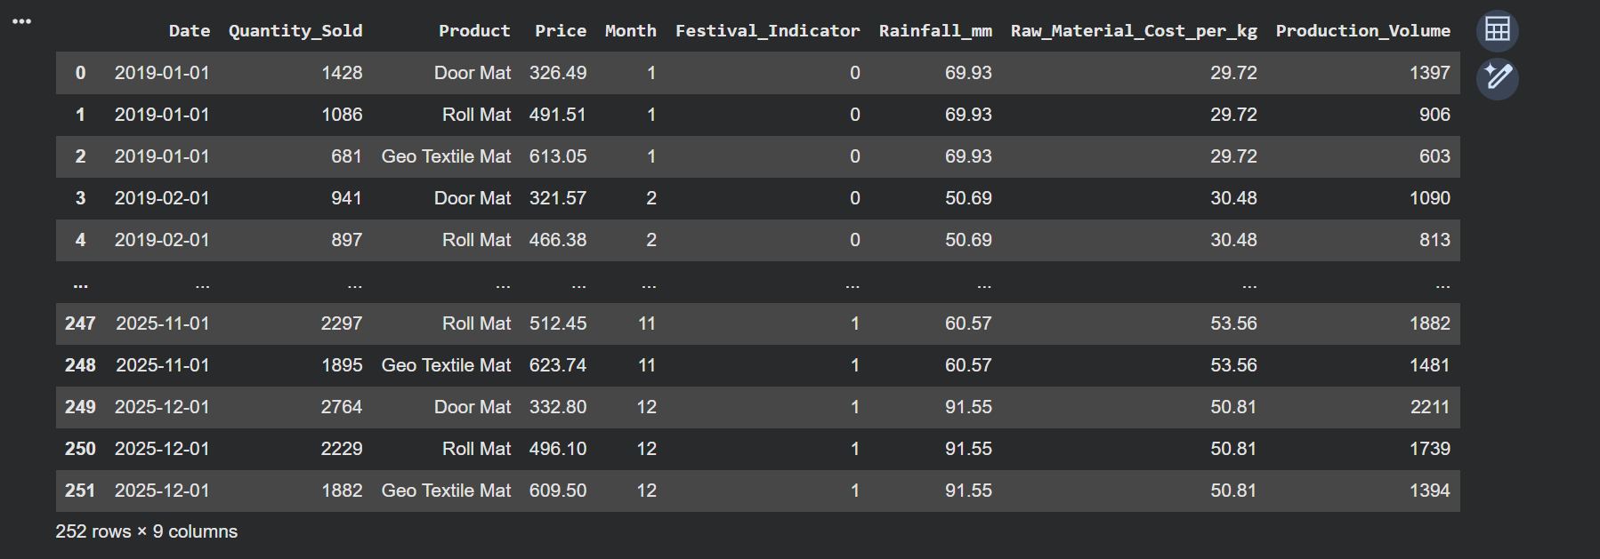
DATASET

Slide 9
TOOLS
1. XGBoost (Extreme Gradient Boosting)
Builds a strong predictive model by combining multiple weak learners (usually decision trees) sequentially.
Each new learner focuses on correcting the errors (residuals) made by previous models.
Uses gradients from a loss function to minimize errors and improve predictions iteratively.
Handles complex nonlinear relationships effectively and delivers high accuracy.
Provides feature importance, improving interpretability and helping in better decision-making

Slide 10
TOOLS
2. ARIMA (AutoRegressive Integrated Moving Average)
A statistical time-series forecasting model widely used in finance, economics, and engineering.
Consists of three components: AR (p) – uses past observations, I (d) – differencing to make data stationary, MA (q) – uses past forecast errors.
Autoregressive (AR) models future values based on previous time steps.
Integrated (I) removes trends using differencing to ensure stationarity, which is essential for ARIMA accuracy.
Moving Average (MA) accounts for short-term fluctuations using error patterns from prior predictions.

Slide 11
TOOLS
3. SARIMA (Seasonal AutoRegressive Integrated Moving Average)
Purpose: Forecast time series with trend + seasonality
Model structure: Combines ARIMA with seasonal components
Captures:
  Past values (autoregression)
  Trend (differencing)
  Seasonality (repeating patterns, e.g., yearly cycles)
Parameters:
  Non-seasonal: (p, d, q)
  Seasonal: (P, D, Q, s)
  s = seasonal period (e.g., 12 for monthly data)

Slide 12
EVALUATION METRICS
1. MAPE – Mean Absolute Percentage Error
  Measures the average forecast error as a percentage of actual values
  Formula: MAPE = (1/n) Σ |(Actual – Forecast) / Actual| × 100
  Easy to interpret and compare across different datasets
  Lower MAPE = more accurate model
  Highly preferred in business forecasting applications
  Used as the primary accuracy metric in the paper

Slide 13
EVALUATION METRICS
2. RMSE – Root Mean Square Error
  Measures how large the errors are between actual and predicted values
  Formula: RMSE = sqrt((1/n) Σ (Actual – Forecast)²)
  Errors are squared → penalizes large deviations heavily
  Expressed in the same units as the data
  Good for identifying large forecasting mistakes
  Lower RMSE indicates more stable and reliable predictions

Slide 14
EVALUATION METRICS
3.MAE – Mean Absolute Error
  Measures the average magnitude of prediction errors
  Uses absolute values, so negative and positive errors do not cancel each other
  Easy to understand because errors remain in the original unit of data
  Less sensitive to large errors compared to MSE
  Lower MAE indicates better forecasting accuracy

Slide 15
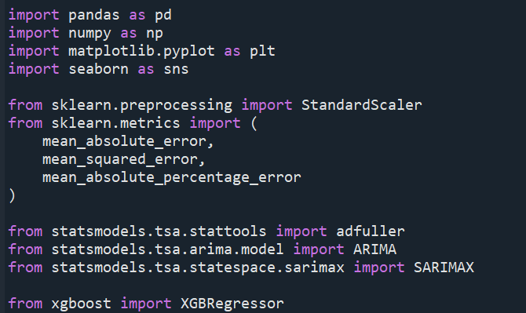
LIBRARIES

Slide 16
PREPROCESSING
Process of converting raw data into clean, usable data before analysis or Machine Learning.
Main Steps of Data Preprocessing
1. Import Libraries & Dataset
  Load dataset using Pandas / NumPy
2. Data Cleaning
  Handle missing values
  Remove duplicates
  Fix incorrect data
  Handle noisy data
3. Data Integration
  Combine multiple datasets
4. Data Transformation
  Normalize / standardize values
  Convert data types
5. Encoding Categorical Data
    Convert text → numbers
    (Label Encoding / One-Hot Encoding)

Slide 17

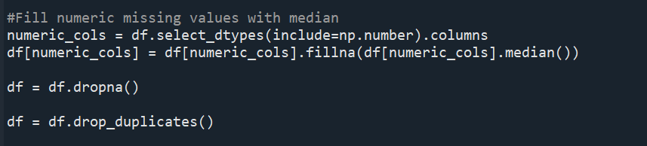

PREPROCESSING AND DATA CLEANING

Slide 18
TRAIN TEST SPLIT
The dataset is divided into two subsets: training data (80%) and testing data (20%) for model development and evaluation.
The training dataset is used to train the forecasting models and allow them to learn demand patterns from historical sales data.
The testing dataset is used to evaluate the prediction performance of the trained models on unseen data.
Train-test splitting helps in measuring the model’s ability to generalize effectively to new real-world demand conditions.
Proper data partitioning prevents the issue of overfitting, where the model memorizes training data instead of learning meaningful patterns.
The split ensures a fair comparison between ARIMA, SARIMA, XGBoost, and hybrid forecasting models using identical test conditions.

Slide 19
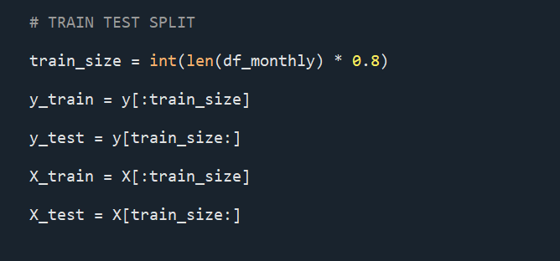
Train-test splitting improves the reliability, robustness, and practical applicability of the forecasting system for industrial demand prediction.

Slide 20
STATIONARITY TEST
The Augmented Dickey–Fuller (ADF) test is used to determine whether a time-series dataset is stationary or non-stationary by checking the presence of a unit root.
The primary purpose of the ADF test is to verify whether the data satisfies the assumptions required for time-series forecasting models such as ARIMA and SARIMA.
Stationarity testing is important because non-stationary data can produce misleading statistical relationships and unreliable forecasting results.
The ADF test helps identify trends, seasonality, and structural variations present in the demand data before model development.
Performing the ADF test improves forecasting reliability by ensuring that appropriate preprocessing techniques such as differencing or hybrid modelling are applied when necessary.

Slide 21
ADF STATIONARITY TEST
Product | ADF p-value | Interpretation
Door Mat | 0.973 | Strong Non-Stationary
Roll Mat | 0.659 | Non-Stationary
Geo Textile Mat | 0.385 | Non-Stationary

Slide 22
ADF TEST INTERPRETATION
A p-value greater than 0.05 indicates that the time-series data is non-stationary and contains trends or seasonal variations.
Non-stationary demand data suggests that sales patterns change over time and cannot be modeled accurately using basic statistical forecasting methods alone.
The ADF test results confirmed the presence of trend and seasonality in the product demand data, making preprocessing and hybrid modelling necessary.
Since the dataset was found to be non-stationary, advanced forecasting approaches such as SARIMA and Hybrid SARIMA-XGBoost were applied to improve prediction accuracy.
The ADF interpretation helped in selecting appropriate forecasting techniques capable of handling seasonal and nonlinear demand behaviour effectively.

Slide 23
Feature Scaling
Feature scaling is a preprocessing technique used to standardize input variables into a common numerical range before training machine learning models.
The main purpose of feature scaling is to ensure that variables with larger numerical values do not dominate the learning process of the model.
Feature scaling is important for machine learning algorithms such as XGBoost and hybrid models because it improves model stability, convergence speed, and prediction consistency.
In this study, the StandardScaler technique was applied to transform the data into a standardized format with a mean of 0 and standard deviation of 1.
Feature scaling improves forecasting accuracy, reduces computational bias, and enhances the overall performance of machine learning-based demand forecasting models.

Slide 24
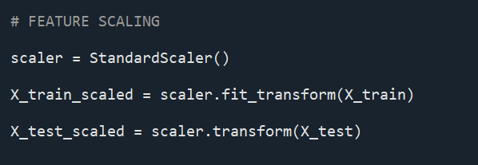

Slide 25
Hybrid ARIMA-XGB
Hybrid ARIMA-XGB combines the statistical forecasting capability of ARIMA with the nonlinear learning capability of XGBoost to improve time-series prediction accuracy.
The primary purpose of the Hybrid ARIMA-XGB model is to capture both linear trends and nonlinear residual patterns present in complex demand datasets.
In this hybrid approach, ARIMA first models the linear temporal structure, and XGBoost is then applied to predict the residual errors generated by the ARIMA model.
The model is important because standalone forecasting methods often fail to accurately represent seasonal fluctuations and nonlinear sales behaviour in industrial demand forecasting.
Hybrid ARIMA-XGB improves forecasting accuracy, reduces prediction error, enhances model robustness, and provides better real-world forecasting performance compared to traditional individual models.

Slide 26
Hybrid SARIMA-XGB
Hybrid SARIMA-XGB combines the seasonal forecasting capability of SARIMA with the nonlinear learning capability of XGBoost to improve demand forecasting accuracy.
The primary purpose of the Hybrid SARIMA-XGB model is to capture:
  seasonal trends using SARIMA
  nonlinear residual patterns using XGBoost.
In this hybrid approach, SARIMA first models the linear and seasonal behaviour of the time-series data, while XGBoost predicts the residual errors not captured by SARIMA.
The model is important because industrial demand data contains complex seasonal fluctuations, external influences, and nonlinear sales behaviour that standalone models often fail to represent accurately.
Hybrid SARIMA-XGB improves forecasting accuracy, reduces prediction error, enhances model robustness, and provides better support for inventory planning, production scheduling, and export demand management.

Slide 27
DOOR MAT RESULTS
Method | MAE | RMSE | MAPE
ARIMA | 308.06 | 407.26 | 12.31%
SARIMA | 225.00 | 248.37 | 9.86%
XGBoost | 245.10 | 350.51 | 9.79%
Hybrid ARIMA | 220.77 | 273.53 | 9.28%
Hybrid SARIMA | 173.05 | 221.38 | 7.66%

Slide 28
INTERPRETATION:-
Hybrid SARIMA achieved the best forecasting accuracy with the lowest error values.
ARIMA produced the highest MAE, RMSE, and MAPE values.
SARIMA performed better than ARIMA due to seasonal pattern learning.
XGBoost captured nonlinear demand behaviour effectively.
Hybrid models outperformed standalone forecasting models for door mat sales prediction.

Slide 29
ROLL MAT RESULTS
Method | MAE | RMSE | MAPE
ARIMA | 323.27 | 364.89 | 16.18%
SARIMA | 229.62 | 280.61 | 11.47%
XGBoost | 197.98 | 256.92 | 9.47%
Hybrid ARIMA | 285.91 | 341.60 | 14.40%
Hybrid SARIMA | 175.86 | 219.34 | 8.49%

Slide 30
INTERPRETATION:-
Hybrid SARIMA achieved the lowest forecasting error for Roll Mat demand prediction.
XGBoost performed better than ARIMA in capturing nonlinear sales behaviour.
SARIMA showed improved accuracy due to effective seasonal pattern modelling.
Hybrid models consistently outperformed standalone forecasting models.
Hybrid SARIMA-XGB provided the most reliable and accurate Roll Mat sales forecasts.

Slide 31
GEO TEXTILE MAT RESULTS
Method | MAE | RMSE | MAPE
ARIMA | 216.12 | 249.74 | 12.67%
SARIMA | 102.73 | 132.82 | 6.78%
XGBoost | 140.60 | 197.69 | 7.80%
Hybrid ARIMA | 117.89 | 165.23 | 6.61%
Hybrid SARIMA | 74.01 | 109.38 | 4.25%

Slide 32
INTERPRETATION:-
Hybrid SARIMA achieved the highest forecasting accuracy with the lowest MAE, RMSE, and MAPE values.
Geo Textile Mat demand showed strong seasonal and nonlinear behaviour.
SARIMA performed significantly better than ARIMA due to effective seasonal modelling.
Hybrid models reduced forecasting error considerably compared to standalone models.
Hybrid SARIMA-XGB provided the most reliable and accurate Geo Textile Mat demand forecasts.

Slide 33
OVERALL PERFORMANCE ANALYSIS
KEY FINDINGS:-
Hybrid SARIMA-XGBoost consistently achieved the lowest MAE, RMSE, and MAPE values across all products.
Hybrid forecasting models performed better than standalone ARIMA, SARIMA, and XGBoost models.
SARIMA effectively captured seasonal demand variations in natural fibre product sales.
XGBoost successfully modeled nonlinear demand behaviour and residual patterns.
The integration of seasonal statistical modelling and machine learning significantly improved overall forecasting accuracy and reliability.

Slide 34
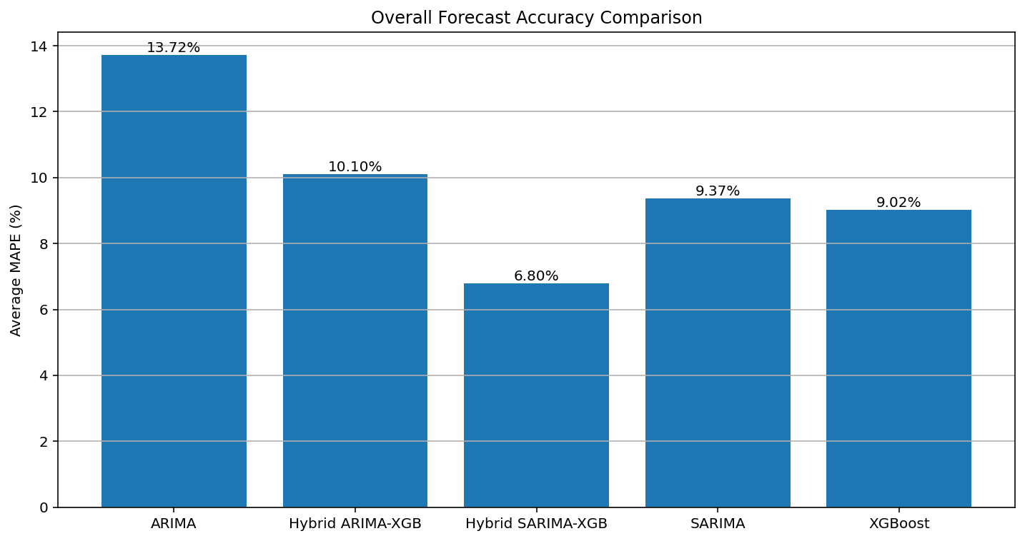

Slide 35
Overall Best Model :- Hybrid SARIMA-XGBoost
Reason
Combines:
  Seasonal forecasting capability
  Nonlinear residual learning
Result
Highest forecasting accuracy across all products.

Slide 36
CONCLUSION
Demand forecasting is essential for export-driven natural fibre industries.
Traditional models showed limitations in handling nonlinear seasonal data.
Hybrid forecasting models improved prediction accuracy significantly.
Hybrid SARIMA-XGBoost achieved the best forecasting performance.
The proposed model can support:
  Inventory planning
  Production scheduling
  Export demand management

Slide 37
REFERENCE
Aburto L and Weber L (2007), “Improved Supply Chain Management Based on Hybrid Demand Forecasts”, Applied Soft Computing,
Anandhi V, Manicka Chezian R and Parthiban K T (2012), “Forecast of Demand and Supply of Pulpwood Using Artificial Neural Network”, International Journal of Computer Science and Telecommunications
Carbonneau R, Laframboise K and Vahidov R (2008), “Application of Machine Learning Techniques for Supply Chain Demand Forecasting”, European Journal of Operational Research
Chiu M and Lin G (2004), “Collaborative Supply Chain Planning Using the Artificial Neural Network Approach”, Journal of Manufacturing Technology Management
Chopra S and Meindl P (2004), “Supply Chain Management: Strategy, Planning and Operation, Prentice Hall.

Slide 38
THANK YOU

